Slide 1
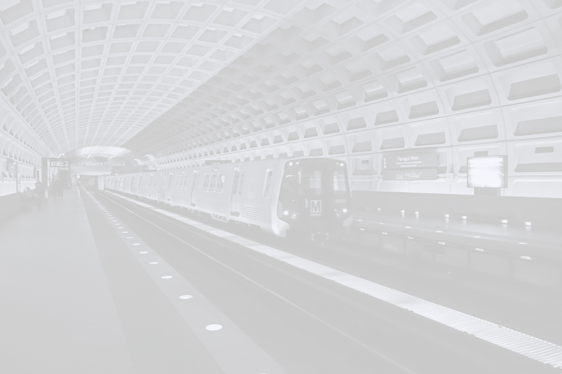


Mindpetal DC Ridership Analysis
IC
25
Kavin Manivannan
University of Maryland Baltimore County

Slide 2
!
Problem
WMATA Metro ridership has dropped 46% since 2009.
Source: National Transit Database
What factors contributed to ridership decline?
How do we solve this?
IC
25
University of Maryland Baltimore County

Slide 3
The Data
IC
25
WMATA Ridership Summary
Data on Daily Ridership across 98 Metro stations during periods in a day, across 8 days in 2024.
Metro Center Ridership during PM Peak Hours on 09/04/2024
External Data:
2014 & 2019 WMATA Ridership Summary
National Annual Ridership
DC Crime Data
University of Maryland Baltimore County

Slide 4
My Analysis
IC
25
Conducted a comprehensive analysis of WMATA Ridership Summary
Identify target groups that influence Ridership
Analyze external data to explain trends in target groups
University of Maryland Baltimore County

Slide 5
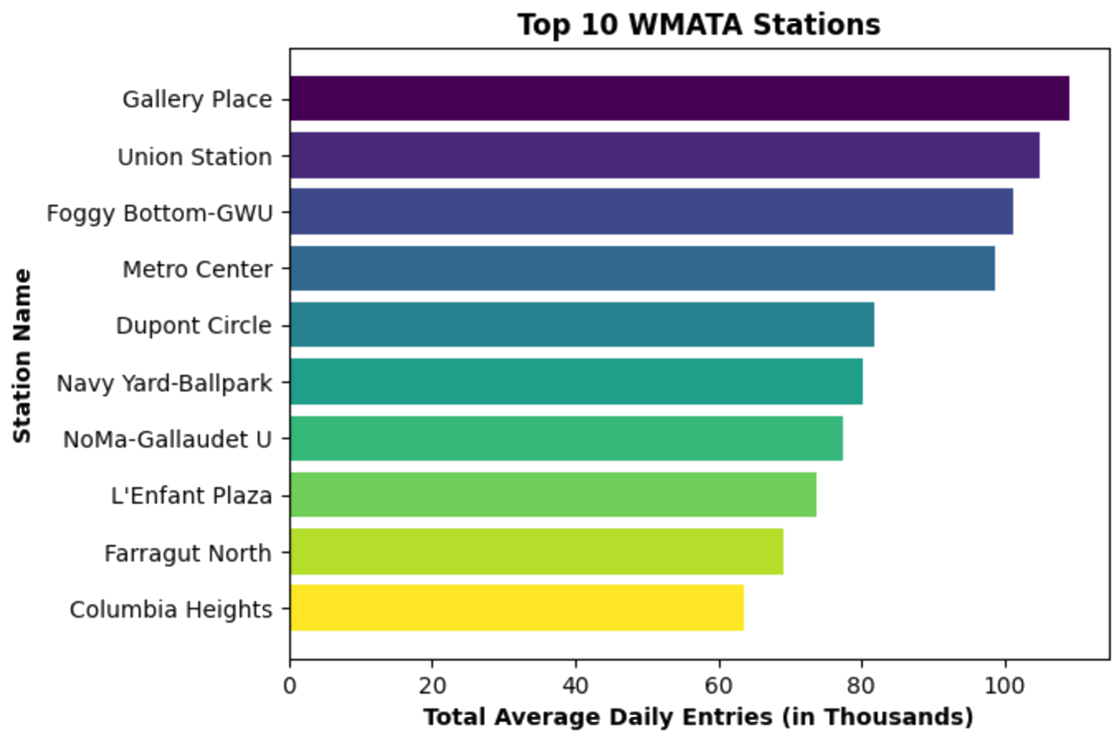
Most Popular Stations
IC
25
University of Maryland Baltimore County

Slide 6
Top 10 Station Demographics
IC
25
Proximity to Federal Buildings:
Union Station, Foggy Bottom-GWU, Metro Center, L’Enfant Plaza, Farragut North
Proximity to Colleges:
Foggy Bottom-GWU, NoMa-Gallaudet U
Other:
Gallery Place, Columbia Heights, DuPoint Circle,
Navy Yard-Ballpark
University of Maryland Baltimore County

Slide 7
Target Groups
IC
25
Federal Workers
College Students
University of Maryland Baltimore County

Slide 8
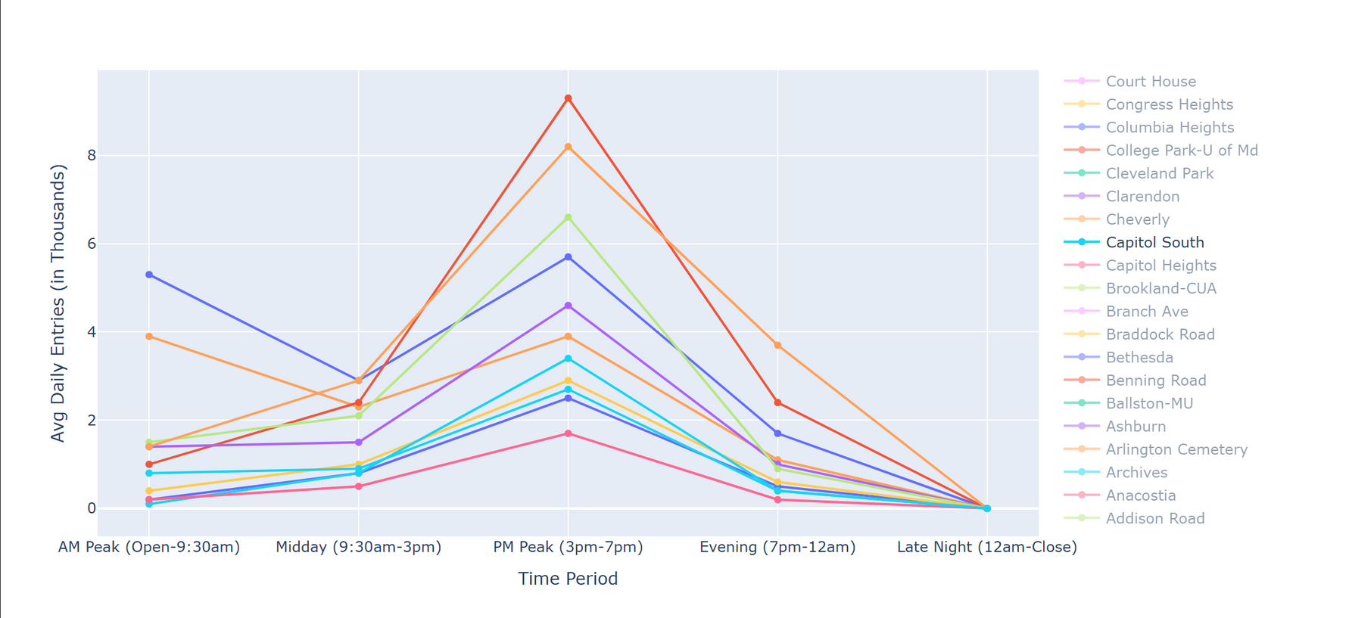






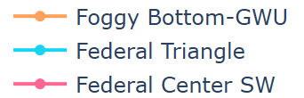


Federal Station Ridership
IC
25
University of Maryland Baltimore County

Slide 9
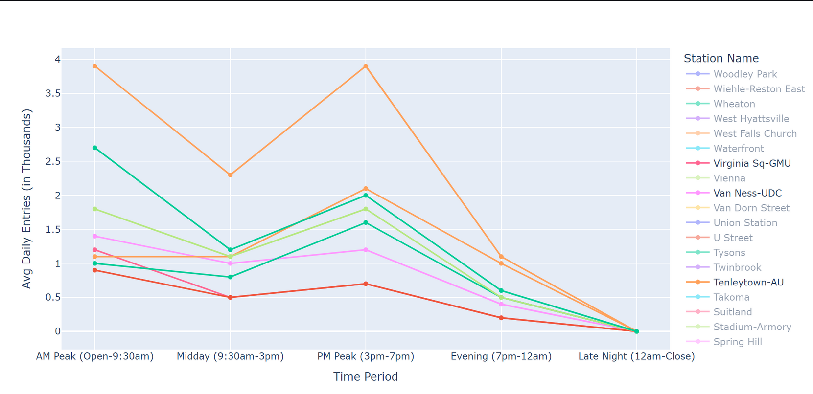
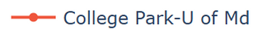





College Station Ridership
IC
25
University of Maryland Baltimore County

Slide 10
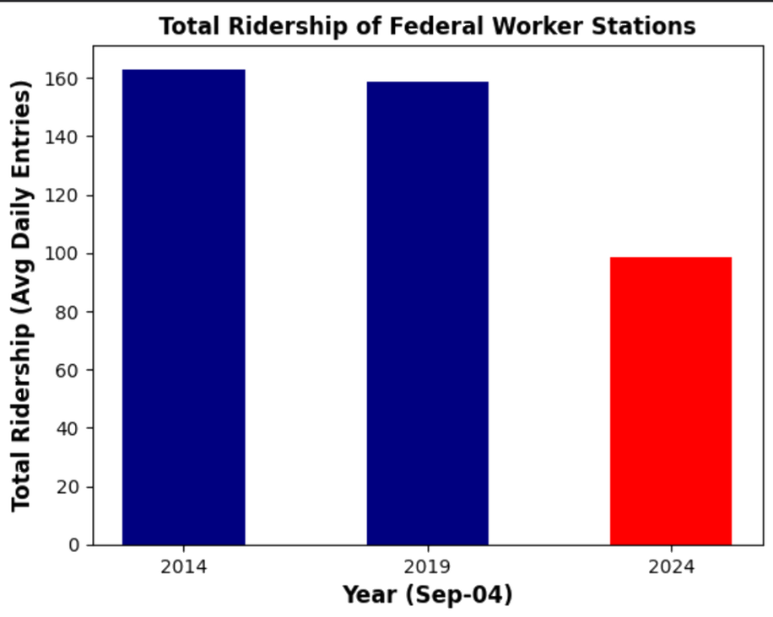
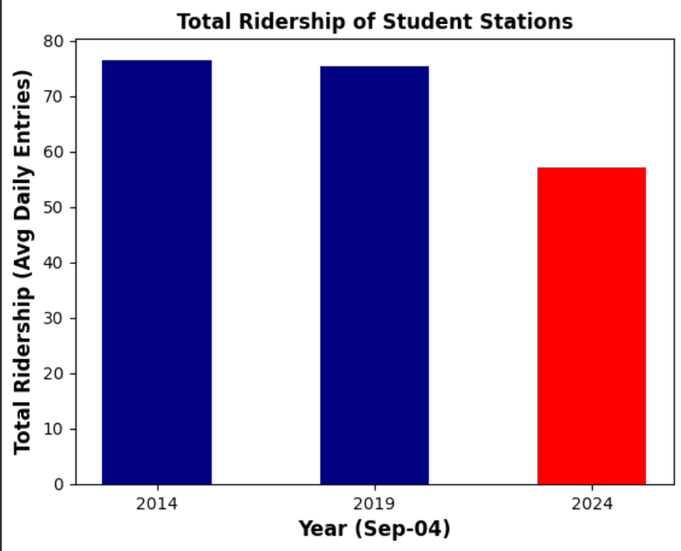
Comparison with Historic Trends
IC
25
25.2%
39.4%
University of Maryland Baltimore County

Slide 11
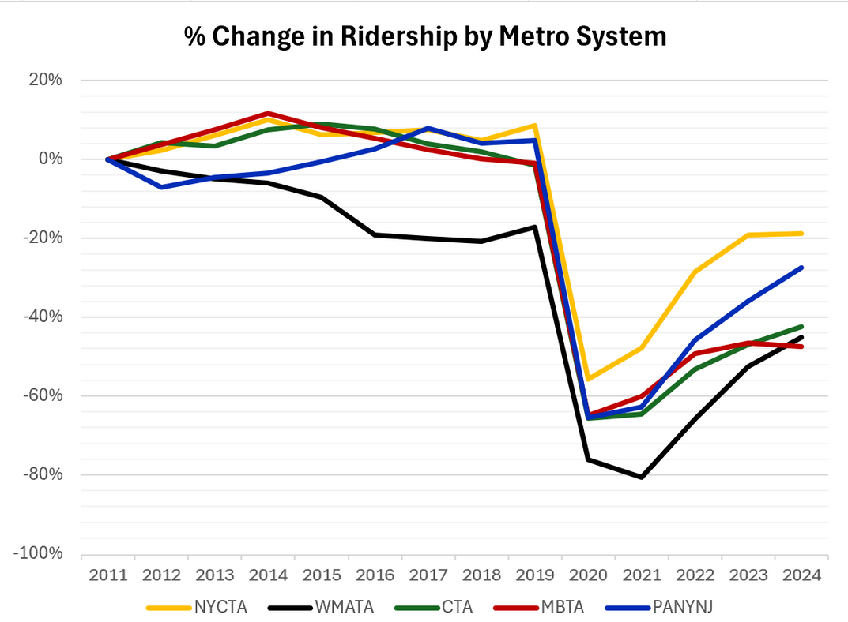
Impact of Ridesharing
IC
25
% Change in Ridership after introduction of Uber
WMATA declined the most
University of Maryland Baltimore County

Slide 12
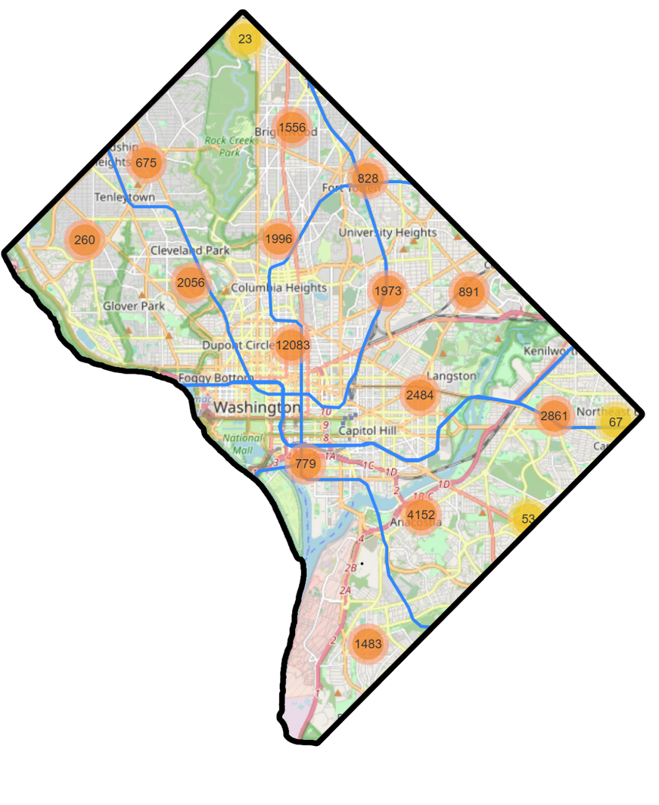
DC Crime Analysis
IC
25
Mapped 34,220 reported crimes
13,259
Theft/Robbery/Burglary
274
Homicides
University of Maryland Baltimore County

Slide 13
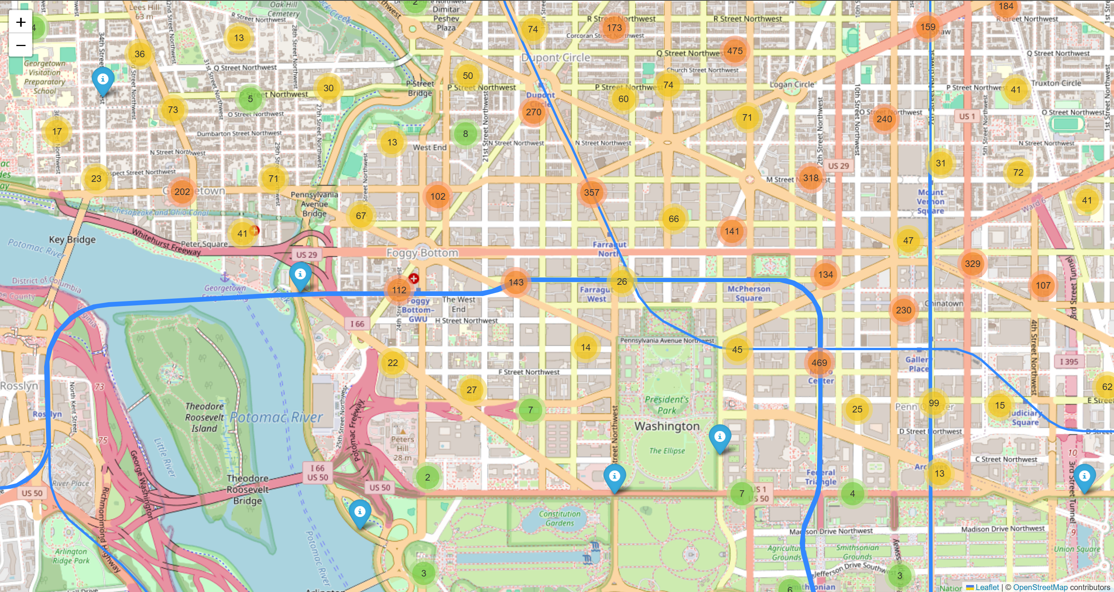
DC Crime Analysis
IC
25

Slide 14
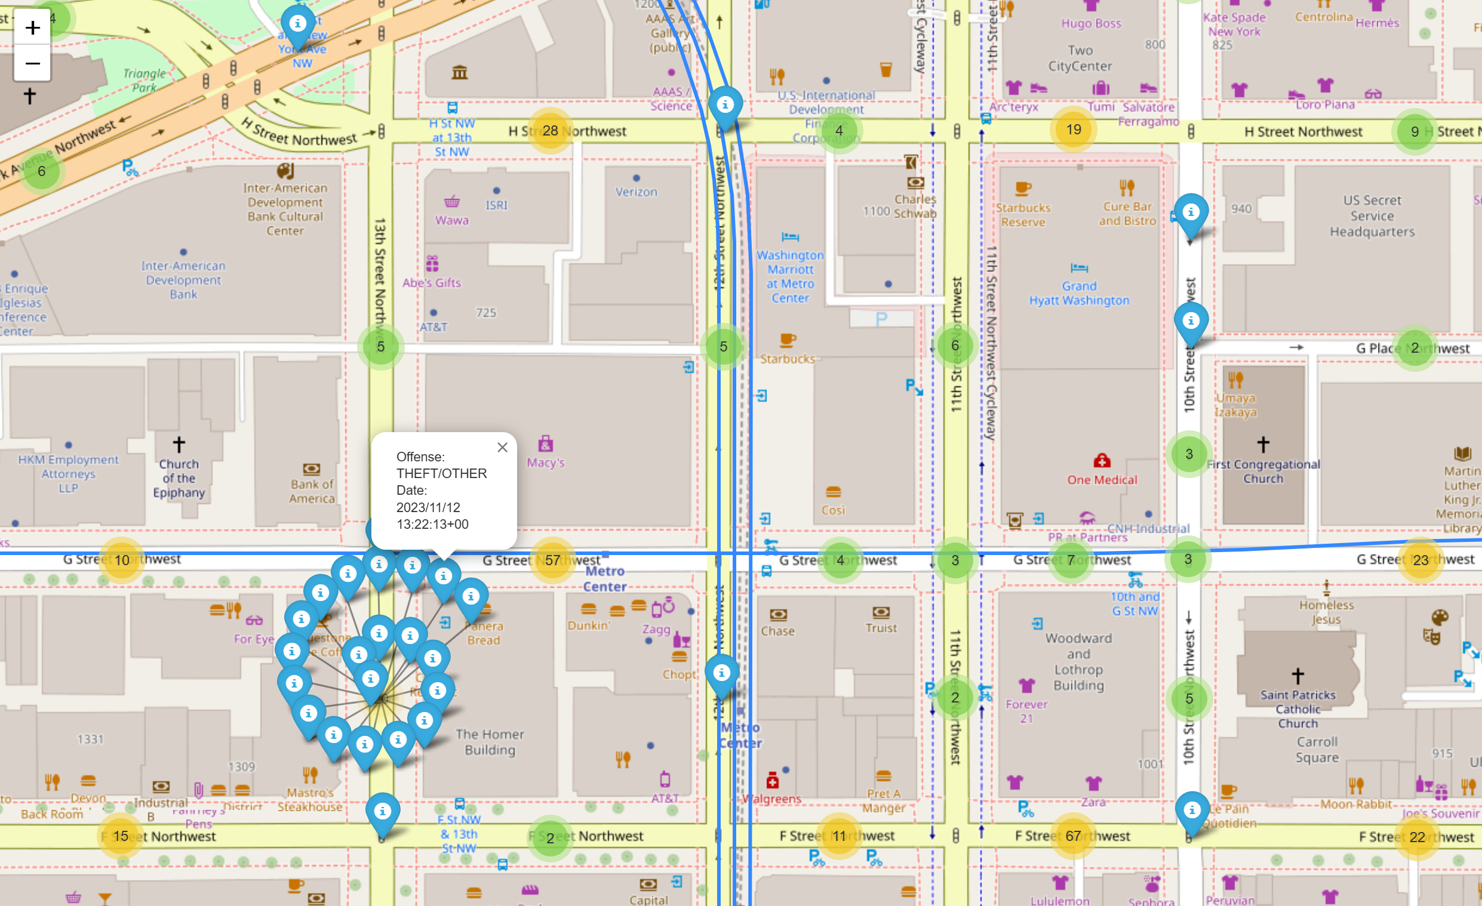
DC Crime Analysis
IC
25

Slide 15
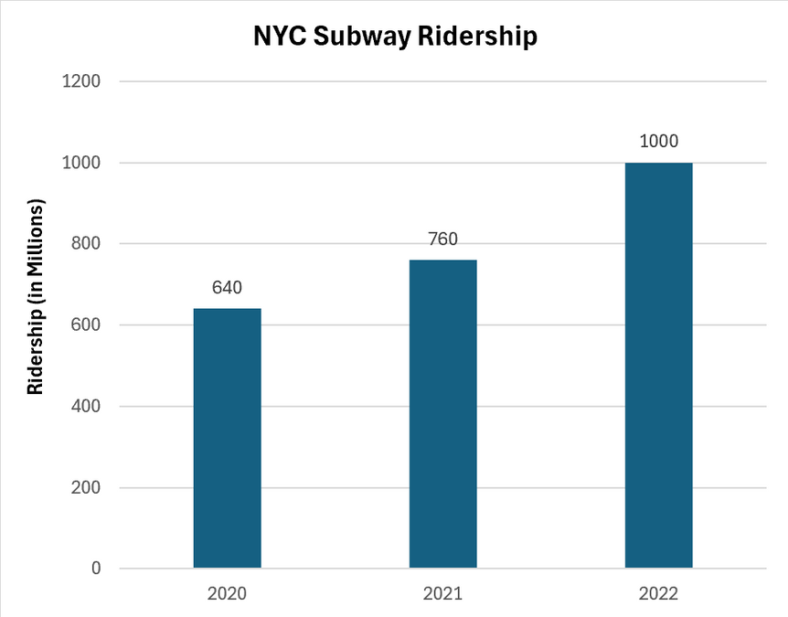
Actionable Insights
IC
25
Increase Security patrols during PM & AM Hours
NYC Subway increased security
Riders report feeling safer
Cost-effective to target stations with higher crime
University of Maryland Baltimore County

Slide 16
Conclusion
IC
25
The WMATA can reverse an overall decline in ridership by increasing security at Federal and College stations and offering fare discounts to federal workers and students during AM and PM Peak hours. Strengthening safety and incentivizing federal workers and students can drive long-term ridership growth.
University of Maryland Baltimore County

Slide 17
Questions?
IC
25
Team 30
University of Maryland Baltimore County
Background Photo Credit: Larry Levine

